Slide 1

Weather Project
Brett Keller
Final Project
08/12/12

Slide 2

The Data
Coordinates
Dates (1940-1945)
Latitude and Longitude
Elevation (m)
Notes:
Distribution of the weather stations concentrated in tropical climates.
Most stations around sea level.
Missing elevations estimated with geographic information.

Slide 3

The Data
Temperature
Average daily temperature (C)
Maximum and Minimum daily temperatures (C)
Notes:
Most of the stations located in relatively warm locations.
A handful of stations located in polar regions.

Slide 4

The Data
Precipitation
Rainfall (mm)
Snowfall (mm)
Notes:
Precipitation assumed to mean rainfall, given snowfall data was unrelated
Trace precipitation (less than 0.01 mm) was rounded to zero
Snowfall includes hail and sleet
A handful of stations did not collect data on snow; they were excluded from relevant analysis

Slide 5
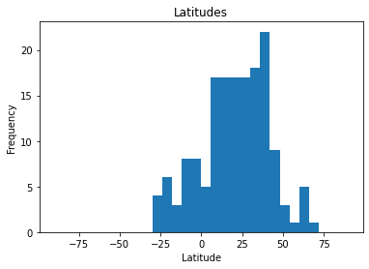
Histograms
Latitudes
Notes:
Northern hemisphere
Closer to equator
Outliers in northern latitudes

Slide 6
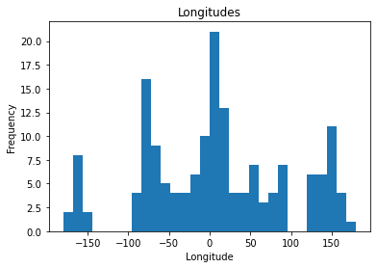
Histograms
Longitudes
Notes:
- Note Pacific Islands and Australia

Slide 7
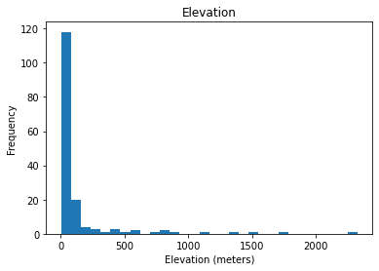
Histograms
Elevation
mean: 130 m or 427 ft
mode: 3 m or 10 ft
sd: 316 m or 1037 ft
max: 2326 m or 7631 ft
Notes:
Mostly near sea level
Nothing below sea level
Max elevation 7,631 ft

Slide 8
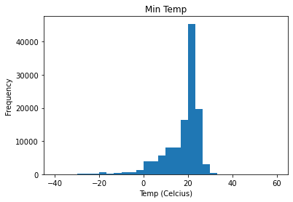
Histograms
Mean Temp
mean: 22.6 C or 72.7 F
mode: 26.7 C or 72.0 F
sd: 8.0 C or 14.5 F
Notes:
Negative skew for temperatures
Some negative outliers due to northerly latitudes

Slide 9
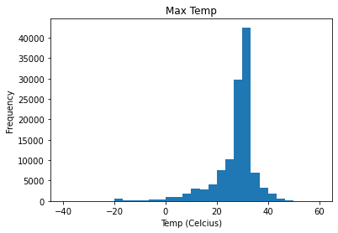
Histograms
Max Temp
mean: 27.3 C or 81.1 F
mode: 30.0 C or 86.0 F
sd: 8.4 C or 15.2 F
max: 50.0 C or 122.0F
Notes:
Hottest temp 122F
World record 134F (Death Valley)

Slide 10
Histograms
Min Temp
mean: 18.0 C or 64.4 F
mode: 22.2 C or 72.0 F
sd: 8.1 C or 14.6 F
max: -38.3 C or -37.0F
Notes:
Coldest temp -37F
World record -129F (Antarctica)

Slide 11
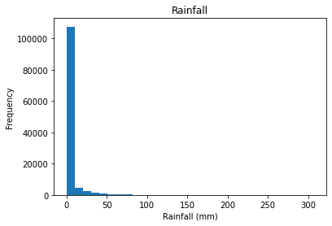
Histograms
Rainfall
mean: 3.2mm or 0.1in
mode: 0.0mm or 0.0in
sd: 10.8mm or 0.4in
max: 307.3mm or 12.1in
Notes:
Heaviest rainfall 12 in
World record 72 in (Réunion)

Slide 12
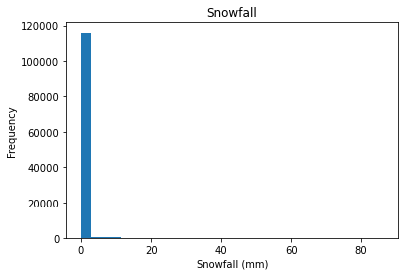
Histograms
Snowfall
mean: 0.2mm or 0.0in
mode: 0.0mm or 0.0in
sd: 2.6mm or 0.1in
max: 86.4mm or 3.4in
Notes:
Heaviest snowfall 3.4 in
World record 78 in (Alaska)

Slide 13
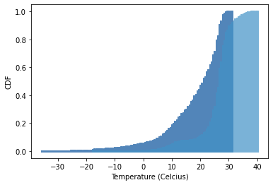
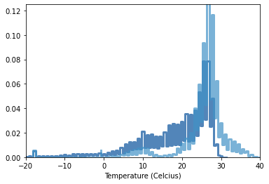
Summer vs Winter
Notes:
Summer hotter than winter
Winter more variable than summer

Slide 14
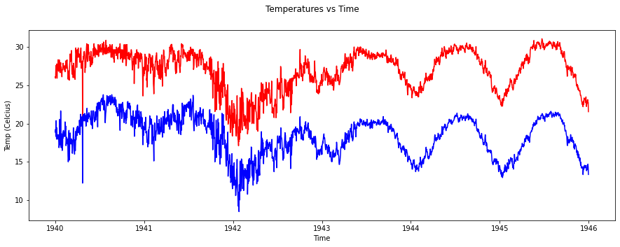
Max vs Min Temperature

Slide 15
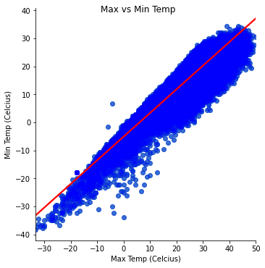
Max vs Min Temperature
Covariance: 59.6
Pearson’s r: 0.88
Notes:
Smoothed out outliers
Strong positive linear relationship

Slide 16
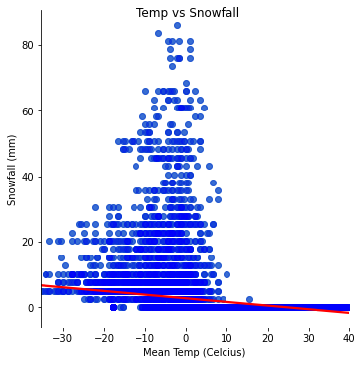
Temperature vs Snowfall
Covariance: -7.14
Pearson’s r: -0.34
Notes:
Weak negative relationship
Likely nonlinear model will do better

Slide 17

April Showers?
Notes:
- Is April the rainiest month?

Slide 18
April Showers?
April
2.6mm or 0.1in
8 days of rain
September
4.1mm or 0.2in
11 days of rain
T-Test
T-statistic: 9.96
P-value: 2.6 x 10^-23
Notes:
September is the rainiest across all stations
Statistically significant

Slide 19

Temperature Regression Model
Notes:
- To predict mean temperature

Slide 20
Temperature Regression Model
Coefficients
Latitude: -0.22
Month: 0.12
Longitude: -0.01
Elevation: -0.01
Mean Squared Error
44.2
Coefficient of Determination
0.32

